Slide 1
Quadrilaterals and their Properties
ART INTEGRATED ACTIVITY
~Alisha Kulshrestha 9B

Slide 2
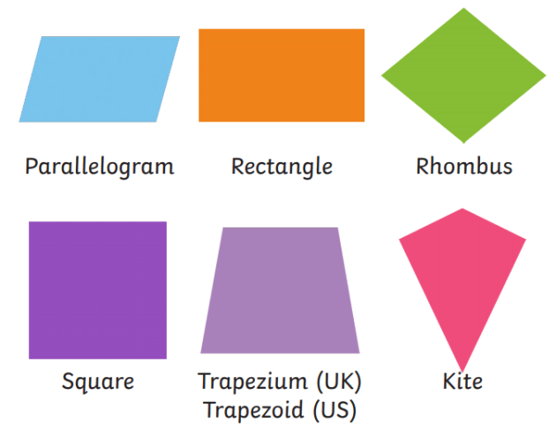
QUADRILATERALS
Four sided closed simple figures
Based on their shapes and sides the get special names
Types of quadrilaterals
Parallelogram
Trapezium
Kite
Square
Rhombus
Rectangle

Slide 3
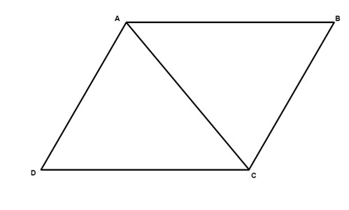
Parallelogram
One special kind of polygons is called a parallelogram. It is a quadrilateral where both pairs of opposite sides are parallel.
There are six important properties of parallelograms to know:
Opposite sides are congruent (AB = DC).
Opposite angels are congruent (D = B).
Consecutive angles are supplementary (A + D = 180°).
If one angle is right, then all angles are right.
The diagonals of a parallelogram bisect each other.
Each diagonal of a parallelogram separates it into two congruent triangles.

Slide 4
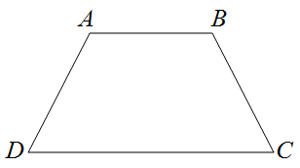
Trapezium
If we have a quadrilateral where one pair and only one pair of sides are parallel then we have what is called a trapezoid. The parallel sides are called bases while the nonparallel sides are called legs.
Properties
1. The bases of a trapezoid are parallel. 2. One of the pair of opposite sides are parallel. 3. Each lower base angle is supplementary to the upper base angle on the same side.

Slide 5
Kite
A kite is a quadrilateral whose four sides can be grouped into two pairs of equal length sides that are adjacent to each other.
Two distinct pairs of adjacent sides are congruent.
Diagonals of a kite intersect at right angles.
One of the diagonals is the perpendicular bisector of another.
Angles between unequal sides are equal.

Slide 6
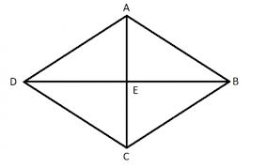
Rhombus
It is a special case of a parallelogram, whose diagonals intersects each other at 90 degrees. This is the basic property of rhombus. The shape of a rhombus is in a diamond shape. Hence it is also called a diamond.
All sides are congruent.
Opposite angles are congruent.
The diagonals are perpendicular to and bisect each other.
Adjacent angles are supplementary.
A rhombus is a parallelogram whose diagonals are perpendicular to each other.

Slide 7
Rectangle
The rectangle is a plane shape with four sides. It is a 4 sided polygon with opposite sides parallel.
The opposite sides are parallel and equal to each other
Each interior angle is equal to 90 degrees
The sum of all the interior angles is equal to 360 degrees
The diagonals bisect each other
Both the diagonals have the same length

Slide 8
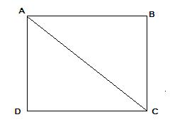
Square
a square is a regular quadrilaterals, which means that it has four equal sides and four equal angles. It can also be defined as a rectangle in which two adjacent sides have equal length.
The diagonals of a square bisect each other and meet at 90°
The diagonals of a square bisect its angles.
Opposite sides of a square are both parallel and equal in length.
All four angles of a square are equal.
All four sides of a square are equal.
The diagonals of a square are equal.

Slide 9
Properties list of quadrilaterals
name of Quadrilateral | Figure/shape | All sides equal | Opposite side equal and parallel | All angles equal | Opposite angles equal | Diagonals equal | Diagonals perpendicular | Diagonals Bisects
Parallelogram |  | no | yes | yes | yes | no | no | yes
Square |  | yes | yes | yes | yes | yes | yes | yes
Rectangle |  | no | yes | yes | yes | yes | no | yes
Rhombus |  | yes | yes | no | yes | no | yes | yes
Trapezium |  | no | ONE PAIR IS PARALLEL BUT NOT EQUAL | no | no | no | no | yes
Kite |  | ONLY TWO PAIR OF ADJACENT SIDES ARE EQUAL | no | no | ONLY ONE PAIR | no | yes | yes

